Slide 1
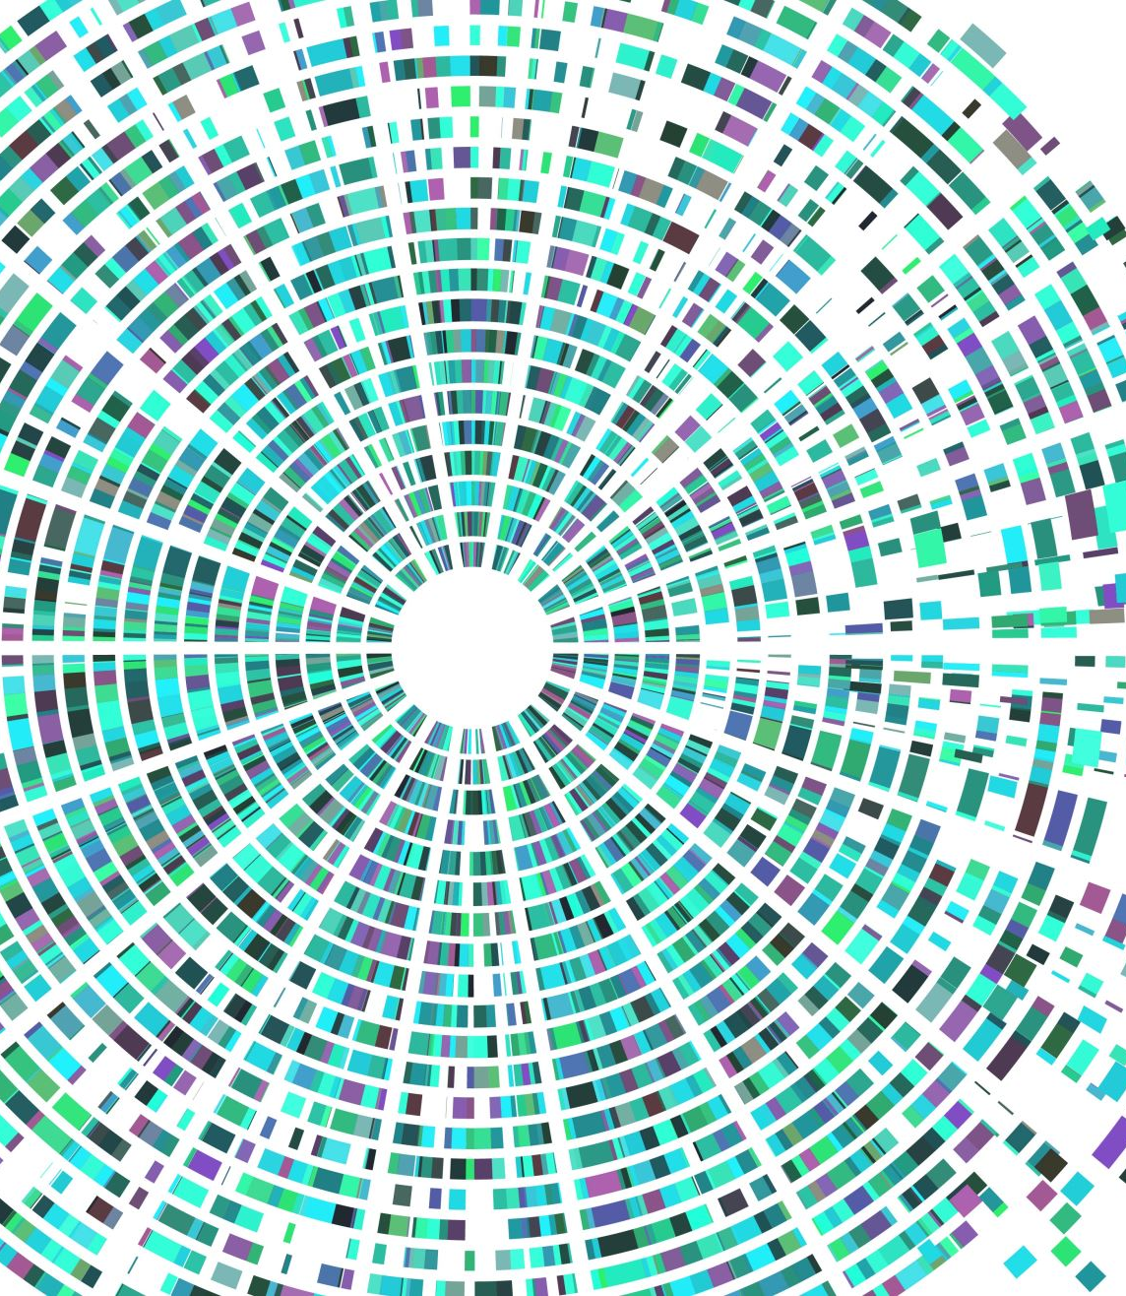
Maze Solver
BY ALEXANDER JOSLIN

Slide 2
Description
This is a graphical user interface where users can select their maze size, number of obstacles, and solving speed.
Then a maze is generated.
The user can then pick and algorithm to solve their maze.
The choices are depth-first search or bread-first search

Slide 3
Backend work Step 1:
Generate a matrix starting with 1 up to a squared number.
Example:
If size = 3 then your resulting matrix is:
[[1, 2, 3], [4, 5, 6], [7, 8, 9]]

Slide 4
Backend work Step 2:
Create a boarder around your matrix.
Create walls within your matrix.
They border and walls can be represented by a 0
Example:
[[0, 0, 0, 0, 0],
[0, 1, 2, 0, 0], [0, 4, 5, 6, 0], [0, 0, 0, 9, 0],
[0, 0, 0, 0, 0]]

Slide 5
Backend work Step 3:
Create a graph based on the matrix.
Scan the matrix left to right and add each element and their adjacent nodes to the graph excluding any 0s.
Example:
[[0, 0, 0, 0, 0],
[0, 1, 2, 0, 0], [0, 4, 5, 6, 0], → [1:[2, 4], 2:[1,5], 4:[1,5], 5:[4,2], 6:[5,9], 9:[6], 9:[]] [0, 0, 0, 9, 0],
[0, 0, 0, 0, 0]]

Slide 6
Backend work Step 4:
Implement depth-first search.
Mine was made recursively.
The visited list from DFS is the resulting path.

Slide 7
Backend work Step 5:
Implement breadth-first search.
Mine was made iteratively using a Queue.
The visited list from BFS is the resulting path.

Slide 8
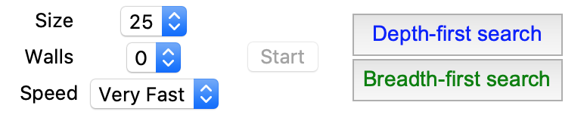
Frontend work Step 6
Create a GUI consisting of 2 buttons for DFS and BFS, dropdown menus to select the maze size, number of obstacles, path finding speed, labels, and a start button.
Mine:
(I used tkinter as my Python GUI library)

Slide 9
Frontend work Step 7
Link the buttons, dropdown menus, ect.. to their corresponding functions

Slide 10
Frontend work Step 8
Make a canvas where you will display the maze

Slide 11
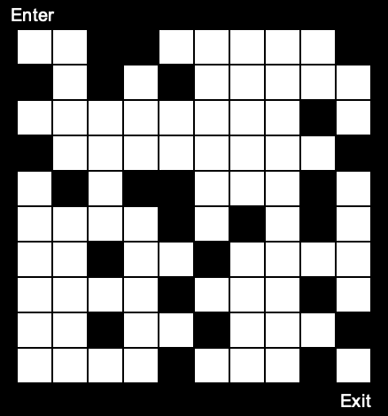
Frontend work Step 9
Display the maze. To do this, scan the matrix left to right and create different squares for the numbers.
Mine:
The black square correspond
to the 0s in my matrix
The white squares are the rest
of the numbers

Slide 12
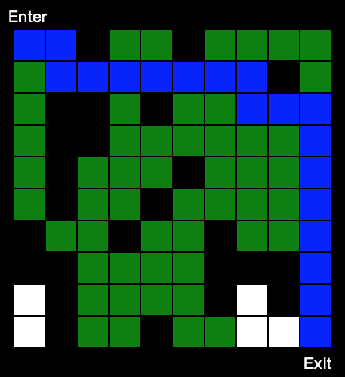
Frontend work Step 10
Display DFS and BFS. Before this, you must have a tracker dictionary that book keeps nodes and their corresponding x and y coordinate.
Loop through the visited list and display all nodes at their corresponding x and y coordinate.
Mine:

Slide 13
Extras
Add a label that lists the maze’s entrance and exit.
Show how many steps it took to complete the maze
Show if the maze is solvable
Color the maze, add sound
Be creative as possible

